Slide 1
Al-MALIK SCIENTIFC AND ELECTRONIC INTRUMENTS Inc.

Slide 2
ALMALIK SCIENTIFIC AND ELECTRONICS ® - Serving Since 1970 📅
Your Trusted Source for Electronic Instruments, Industrial Machinery, and Medical Equipment 🌐
We've been at the forefront of technology for over 50 years, providing top-notch solutions for your electronic, industrial, and medical needs. Explore our wide range of cutting-edge products and services. Let's innovate together!

Slide 3
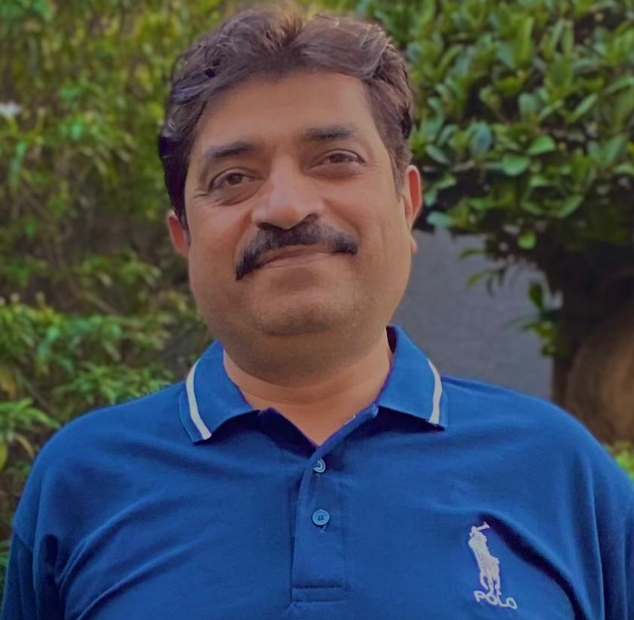
TEAM
SHAHBAZ HASSAN MALIK
CEO
MALIK SOHAIB IQBAL
MANAGER
SHAHROZ QURESHI
PCB ASSEMBLER
MUHAMMAD ARSLAN
PCB ASSEMBLER

Slide 4
PROJECTS
HIGHER EDUCATION:-
SEMI CONDUCTOR DIODE APPARATUS, OHM’S LAW APP, TUNGSTEN FILAMENT LAMP APP, STEP UP/DOWN TRANSFORMER APP, AMPLIFIER AS AN OSCILLATOR APP,TRUTH TABLE (AND,OR,NOT,NAND,NOR), RESISTANCE IN SERIES/PARALLEL, CAPACITOR IN SERIES/PARALLEL, ETC.
B.S LEVEL:-
E/M APPARATUS, PLANCK’S CONSTANT APPARATUS, IONIZATION APPARATUS, B-H CURVE APPARATUS, WHEAT STONE BRIDGE APPARATUS, KUND’S TUBE APPARATUS.

Slide 5
ACHIEVEMENTS
"8+ Years of Collaboration with Punjab Group of Colleges"
"Providing Services to Leading Private Schools in Lahore"
"Extending Reach Beyond Lahore to Schools in Rawalpindi, Karachi, Islamabad, Sialkot, and More"
"Range of Physiotherapy Instruments Trusted by Physiotherapists Nationwide"

Slide 6
"Quality Scientific and Electronic Instruments: Serving Pakistan's Academic and Healthcare Communities Since 1970"
AL- Malik Scientific and Electronic Instruments Inc. has been a stalwart in the provision of high-quality scientific and electronic instruments across Pakistan since 1970. With a strong commitment to excellence, they have become a trusted partner for numerous universities and colleges throughout the country. Their dedication to quality products has earned them a reputable standing in the industry. Additionally, their collaboration with physiotherapy doctors underscores their versatility and commitment to serving various fields of expertise with their instruments.

Slide 7
CONTACT
Does anyone have any questions?
EMAIL :- almalikelectronics@hotmail.com
PHONE :- +92 300-9415361
WEBSITE :- www.almalikelectronis.com

